Slide 1






Lecture 13:
Promise Chaining
Course - Web Development - II
-By
Instructor Name
‹#›
welcome@krmangalam.edu.in
Sohna Road,Gurugram,Haryana 122103

Slide 2

| Table of Contents
Chaining Promises
References.
The End.
‹#›

Slide 3
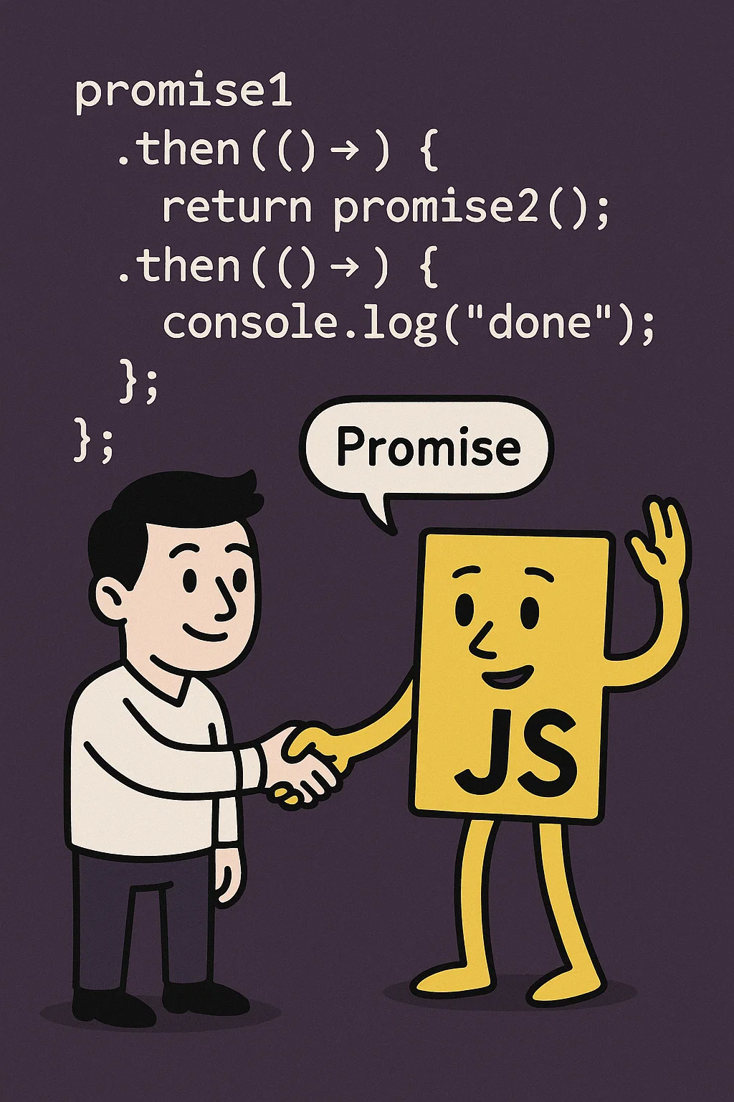
|
Did you know that, just like in real life, we can make one promise depend on the result of a previous promise? JavaScript can do the same — it allows one promise to depend on the outcome of another!
‹#›

Slide 4
|
Did you know that, just like in real life, we can make one promise depend on the result of a previous promise? JavaScript can do the same — it allows one promise to depend on the outcome of another!
Yes! This is exactly where Promise Chaining comes in
Promise Chaining is a technique in JavaScript where multiple asynchronous tasks are linked using .then().
Each .then() runs only after the previous promise is resolved, creating a step-by-step sequence.
If any promise in the chain is rejected (fails), the control jumps to the .catch() block to handle the error.
.finally() block can also be added to execute code at the end of the chain, regardless of whether the promises were fulfilled or rejected.
‹#›

Slide 5
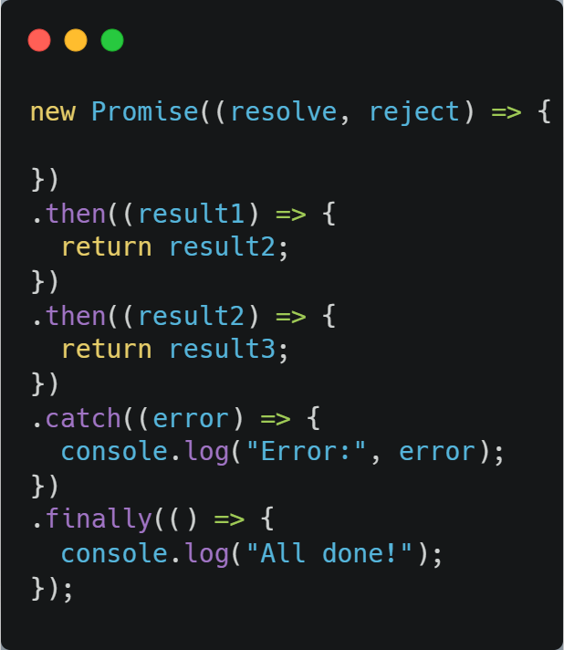
| Promises Chaining
Basic Syntax of Promise Chaining:
‹#›

Slide 6
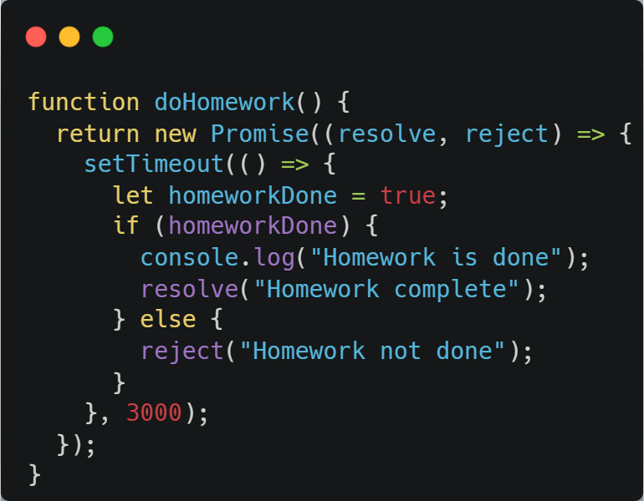
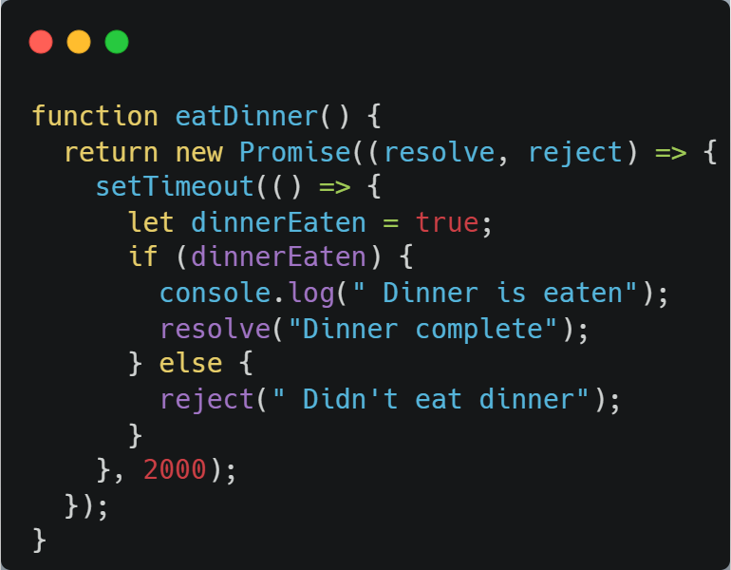
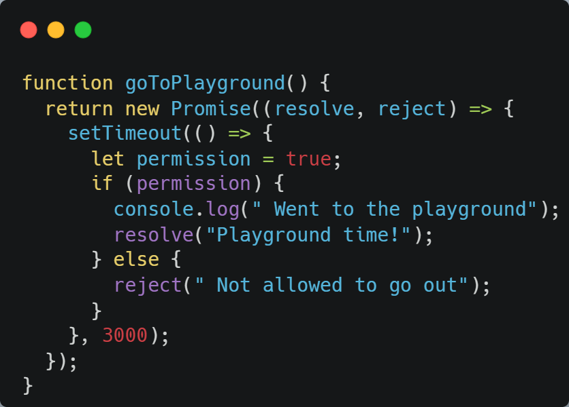
| Promises Chaining
‹#›

Slide 7
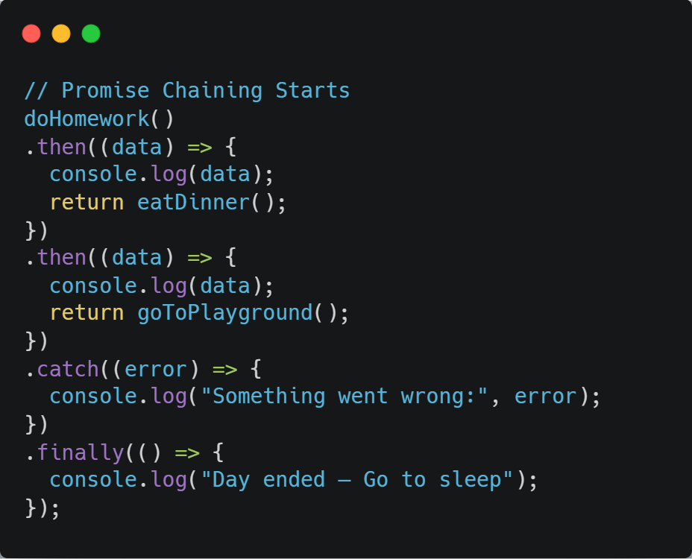
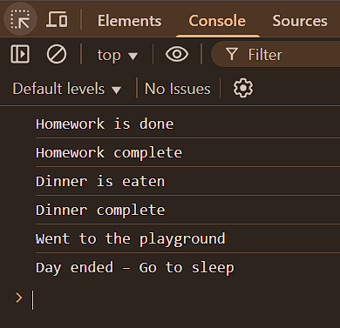
| Promises Chaining
‹#›

Slide 8

|
Do you know… if we have a lot of promise-based code and we want to make it wait properly, earlier we had to use callback hell — which was super messy.
Then we got promise chaining .then().then().then() — better, but still a bit hard to read.
Do you think something even better exists that can handle async code without callback hell or long promise chains?
‹#›

Slide 9
| Promise Chaining Drawbacks
Drawbacks of Promise Chaining refer to the limitations and challenges that arise when multiple asynchronous operations are handled using a long chain of .then() methods in JavaScript.
Although promise chaining helps manage asynchronous code better than callbacks, it can still lead to problems such as:
reduced readability
difficulty in understanding the execution flow
complicated error handling
performance issues due to sequential execution
poor maintainability
when the chain becomes large or complex.
‹#›

Slide 10

| Coding Questions
1. Creating a Promise
Task :
Create a function delay(ms) that returns a new Promise. This Promise should use setTimeout to wait for the specified number of milliseconds (ms) and then resolve with the message "Action completed after [ms] ms".
‹#›

Slide 11
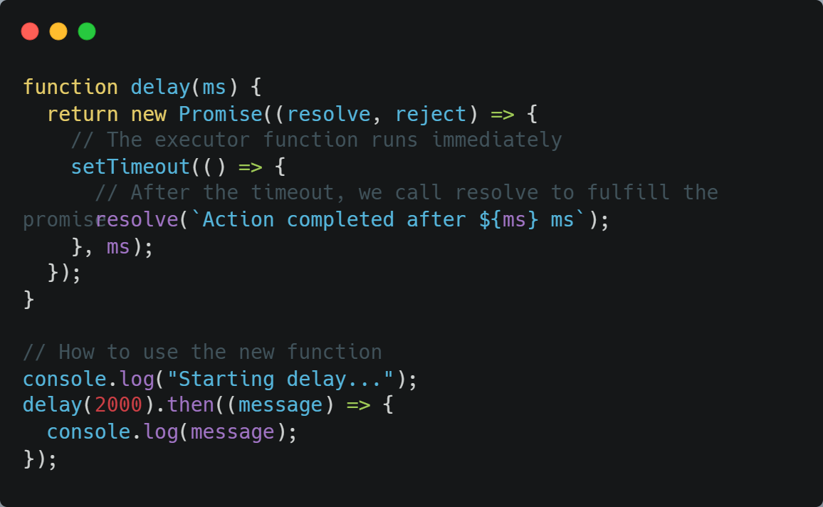
| Coding Questions
Solution :
‹#›

Slide 12
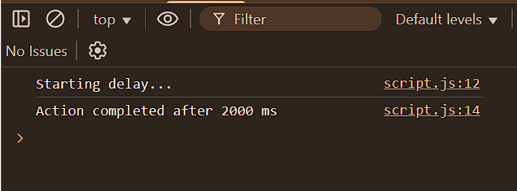
| Coding Questions
Output :
‹#›

Slide 13
| Coding Questions
1. Consuming a Promise
Task :
You are given a function fetchData() that returns a Promise. This promise will randomly either resolve with the data { success: true, data: 'Some data' } or reject with an error "Failed to fetch". Use .then() and .catch() to handle both possible outcomes.
‹#›

Slide 14
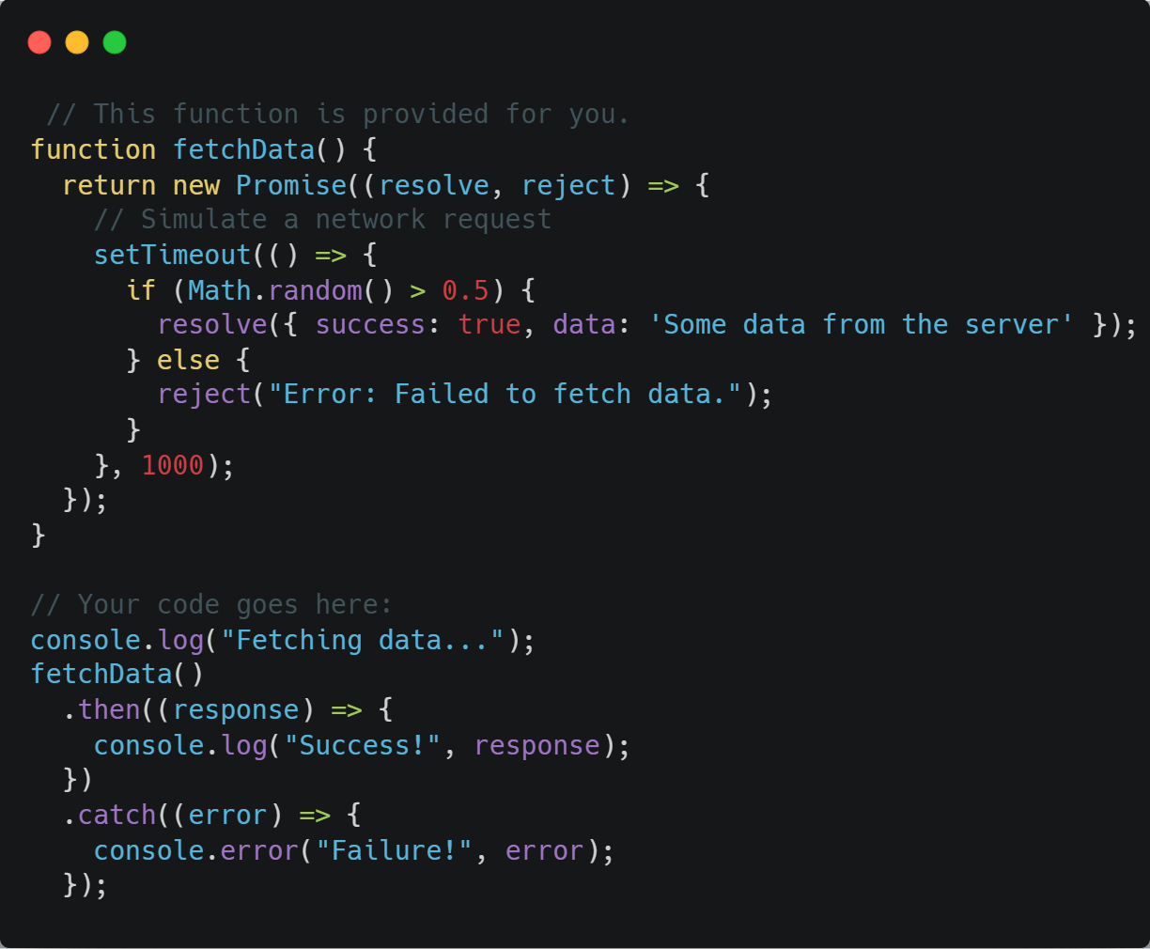
| Coding Questions
Solution :
‹#›

Slide 15
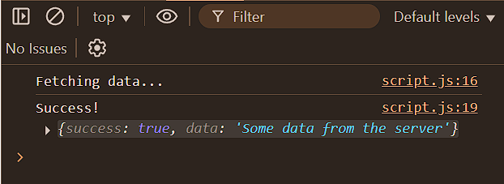
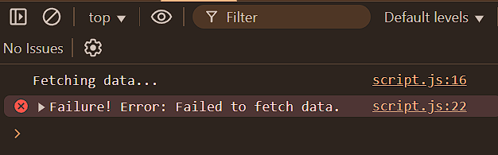
| Coding Questions
Output :
‹#›

Slide 16
| Check Your Understanding
Question : What is a JavaScript Promise?
Options : a) A guarantee that a function will not have any errors.
b) A function that runs synchronously.
c) An object that represents the eventual completion (or failure) of an asynchronous operation.
d) A special type of variable for storing boolean values.
Answer : c) An object that represents the eventual completion (or failure) of an
asynchronous operation.
Explanation:
A Promise is a placeholder for a future value. It allows you to write asynchronous code that is easier to manage than traditional callbacks.
‹#›

Slide 17
| Check Your Understanding
Question : What are the three states a Promise can be in?
Options : a) Start, Middle, End
b) Ready, Set, Go
c) Pending, Fulfilled, Rejected
d) Async, Await, Sync
Answer : c) Pending, Fulfilled, Rejected
Explanation:
A Promise starts as pending, and once the asynchronous operation is complete, it settles into either a fulfilled (successful) or rejected (failed) state.
‹#›

Slide 18
| Check Your Understanding
Question : Which method is used to attach a callback that executes when a Promise is successfully fulfilled?
Options : a) .catch()
b) .then()
c) .finally()
d) .success()
Answer : b) .then()
Explanation:
The .then() method takes a callback function that will receive the resolved value of the promise.
‹#›

Slide 19
| Check Your Understanding
Question : Which method is specifically designed to handle a rejected Promise or an error that occurs in the promise chain?
Options : a) .then(null, errorHandler)
b) .error()
c) .finally()
d) .catch()
Answer : d) .catch()
Explanation:
.catch() is dedicated syntax for handling rejections, making the code cleaner and more readable than passing a second argument to .then(). Both A and D are technically correct, but D is the modern best practice.
‹#›

Slide 20
| References
MDN Web Docs : Comprehensive and official documentation for JS. 🔗https://developer.mozilla.org/en-US/docs/Web/JavaScript
W3Schools – JS Tutorial : Beginner-friendly JS tutorials with examples and interactive editors. 🔗 https://www.w3schools.com/js/
JavaScript.info - A comprehensive tutorial-style website that covers core JavaScript concepts in depth.
🔗https://javascript.info/
‹#›

Slide 21
Thanks
For
Watching
Course - Web Development - II
‹#›
welcome@krmangalam.edu.in
Sohna Road,Gurugram,Haryana 122103

